Slide 1


Inclusive Pronouns Understanding the Importance of Gender Inclusion
START
Notes:
Welcome to the course Inclusive Pronouns – Understanding the Importance of Gender Inclusion.
Click START to begin.

Slide 2

Course Context
This course will help you:
Understand the basics of gender identity and expression
Understand the common terms associated with gender topics
Increase fluency and familiarity in gender pronouns
Please take the course on Subtle Acts of Exclusion (SAE) before proceeding.
02 of 33
Click NEXT to continue.
Notes:
This course is an introduction to gender pronouns and how to use them appropriately. It will help you understand the basics of gender identity and expression, common terms associated with gender topics, and increase fluency and familiarity in gender pronouns.
This learning aims to help you move along the intercultural development continuum from a monocultural lens to a place of acceptance and adaptation.
This course builds on the Subtle Acts of Exclusion (SAE) learning. Many of the examples used in this course include SAE. So, please take the course on SAE before proceeding.

Slide 3


Learning Objectives
Upon completion, you will be able to:
Differentiate between gender identities
Explain gender-inclusive pronouns
Address diverse groups with empathy
03 of 33
Click NEXT to continue.
Notes:
By the end of this course, you will be able to:
Differentiate between gender identities,
Explain gender-inclusive pronouns, and
Address diverse groups with empathy.

Slide 4




Course Structure
Gender Identities
Gender Pronouns
Shift your Thinking
Summary
04 of 33
Notes:
Here’s how the course is structured.
You will learn about gender identities, use of gender-inclusive pronouns while addressing the common concerns one could face, and empathize with an individual by incorporating best practices of gender inclusion in the workplace.
You will then wrap up with a quick Summary.

Slide 5
Course Structure
Gender Identities
Gender Pronouns
Shift your Thinking
Summary
04 of 33
Click NEXT to continue.
Notes:
Let’s begin with the first topic – Gender Identities.

Slide 6
Think About It
What is your dominant hand? Are you a lefty or a righty or ambidextrous?
Click and drag the slider to your preference.
Lefty
Ambidextrous
Righty
CHECK
05 of 33
Notes:
Here is a quick question.
What is your dominant hand? Are you a lefty or a righty or ambidextrous?
Click and drag the slider to your preference.

Slide 7
Think About It
Update OS
What is your dominant hand? Are you a lefty or a righty or ambidextrous?
Click and drag the slider to your preference.
Lefty
Ambidextrous
Righty
It's hard to explain how or why we know this about ourselves, but we just know. Writing with your dominant hand feels natural, more coordinated, stronger, and even more confident. Similar to having a dominant hand, it’s hard to explain how we know what our gender is. We just know.
05 of 33
Click NEXT to continue.
Notes:
Most people learn at an early age whether they are a righty or a lefty, or even ambidextrous. It’s hard to explain how or why we know this about ourselves, but we just know. Writing with your dominant hand feels natural, more coordinated, stronger, and even more confident.
Historically, people who were left-hand-dominant were once forced to use their right hand in school, which is not only awkward and uncomfortable, but also caused immense stress and anxiety. Similar to having a dominant hand, it’s hard to explain how we know what our gender is.
We just know. And being forced to present as a gender identity that doesn’t align with who you know yourself to be at your strongest, is a painful experience.

Slide 8

What is Gender Identity?
Gender identity is who you know yourself to be. It is who you are at your core.
Click each tab to learn more.
Gender Expression
Gender Inclusion
06 of 33
Notes:
Gender identity is who you know yourself to be. It is who you are at your core.
Click each tab to learn more.

Slide 9
What is Gender Identity?
Gender identity is who you know yourself to be. It is who you are at your core.
Click each tab to learn more.
Gender Expression
Gender expression is how you present yourself to the world, whether feminine, masculine, or something else entirely.
Gender Inclusion
06 of 33
Notes:
Gender expression is how you present yourself to the world, whether feminine, masculine, or something else entirely.
While society has typically taught us that gender is a binary between male and female, in truth, gender is a spectrum with infinite ways to know and feel yourself to be inside. Understanding this helps us respect all individual identities.

Slide 10
What is Gender Identity?
Gender identity is who you know yourself to be. It is who you are at your core.
Click each tab to learn more.
Gender Expression
Gender Inclusion
Gender inclusion is understanding that people are allowed to express their authentic gender identity and present in a way that they feel most confident, natural, and strong.
06 of 33
Click NEXT to continue.
Notes:
Gender inclusion is understanding that people are allowed to express their authentic gender identity and present in a way that they feel most confident, natural, and strong.

Slide 11
Sexual Orientation
Sexual orientation (sexuality) is about your external attraction to others.
It's about who you are attracted to physically, emotionally, and romantically.
Examples of sexuality:
Straight
Lesbian
Gay
Bisexual
Attraction to a
different gender
(heterosexual)
Women attracted to
other women
Attraction to
same gender
(homosexual)
Attraction to same
and different genders
Pansexual
Queer
Asexual
Attraction to
all genders
Attraction not defined
by binary system
Little or no attraction
to others
07 of 33
Click NEXT to continue.
Notes:
Sexual orientation, or sexuality, is about your external attraction to others. It is often confused with gender, which is internal and about who you are.
Sexuality is about who you are attracted to physically, emotionally, and romantically.
There are many labels for sexuality, such as Straight, Lesbian, Gay, Bisexual, Pansexual, Queer, Asexual, as well as many others, just as there are infinite ways to identify your gender.

Slide 12
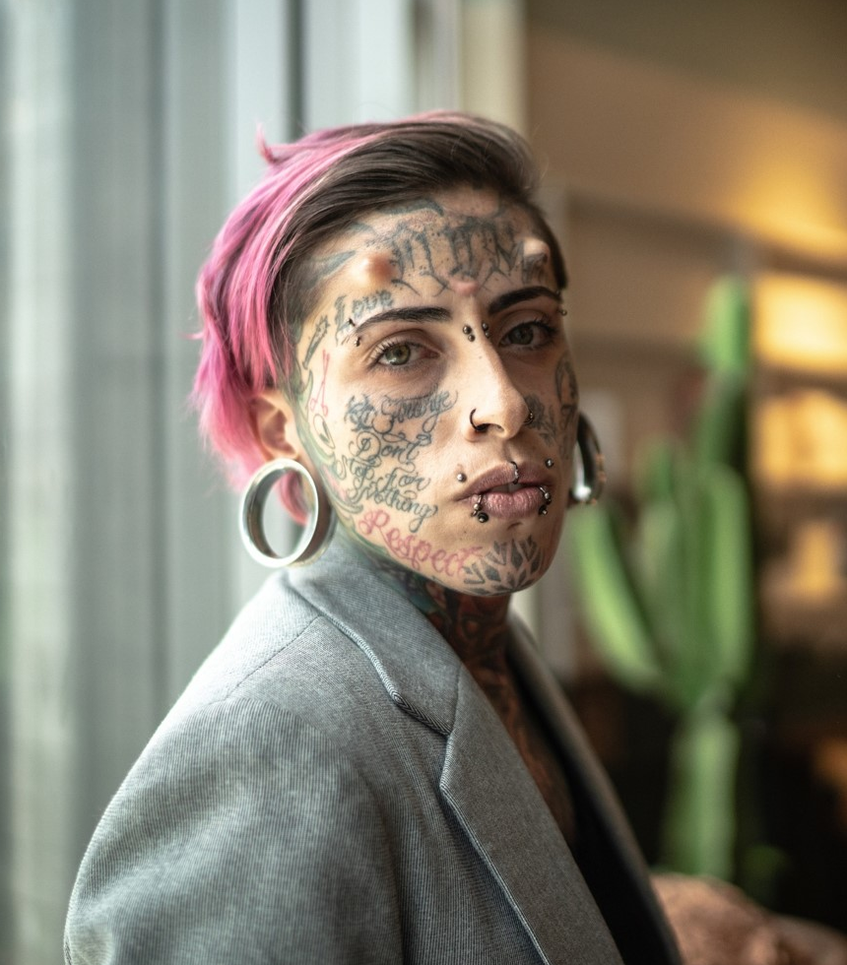
Types of Gender Identities
Click each tab to learn about gender identities.
Cisgender
(cis)
Transgender (trans)
Nonbinary
Intersex
08 of 33
Notes:
Some people identify as Cisgender, Transgender, Nonbinary, Intersex, or Nonbinary and Transgender both. The most important thing to remember is to let people tell you who they are and how they identify, and simply respect that without questioning it.
Click each tab to learn about gender identities.

Slide 13

Types of Gender Identities
AS: comma added
Click each tab to learn about gender identities.
Cisgender
(cis)
Transgender (trans)
Nonbinary
Intersex
A term used for people whose gender aligns with how they were assigned at birth.
The term cisgender is not derogatory. It is simply a descriptor.
08 of 33
Notes:
Cisgender (or cis for short) is a term used for people whose gender aligns with how they were assigned at birth.
For example, when you were born, someone announced that you were a girl, and you’ve grown up your whole life and always felt that to be true, you are a cisgender woman.
The term cisgender is not derogatory. It is simply a descriptor.

Slide 14

Types of Gender Identities
Click each tab to learn about gender identities.
Cisgender
(cis)
Transgender (trans)
Nonbinary
Intersex
A term used for people whose gender identity does not align with how they were assigned at birth.
08 of 33
Notes:
Transgender (or trans for short) is an umbrella term used for people whose gender identity does not align with how they were assigned at birth.
Some trans people undergo gender-confirming medical surgeries, and others do not. It is never appropriate to ask someone if or what surgeries they have had.

Slide 15

Types of Gender Identities
Click each tab to learn about gender identities.
Cisgender
(cis)
Transgender (trans)
Nonbinary
Intersex
A term used for people who identify outside the binary genders male/masculine and female/feminine, and instead identify as both, neither, or a combination.
08 of 33
Notes:
Nonbinary is an umbrella term used for people who identify outside the binary gender system of male/masculine and female/feminine, and instead identify as both, neither, or a combination.
Other terms used by people identifying outside the binary are gender non-conforming (GNC), gender fluid, and genderqueer.

Slide 16

Types of Gender Identities
Click each tab to learn about gender identities.
Cisgender
(cis)
Transgender (trans)
Nonbinary
Intersex
A term used for people who have multiple or ambiguous biological sex characteristics, such as hormones, reproductive organs, and genitalia.
08 of 33
Click NEXT to continue.
Notes:
Intersex is a term used for people with multiple or ambiguous biological sex characteristics, such as hormones, reproductive organs, and genitalia.
Some people do not discover they are intersex until they reach puberty, when various secondary sex characteristics, like hormones, start to take place. In California, it is now illegal to perform surgery on babies who are born intersex.

Slide 17
Challenge
Match each term to its correct description.
Click and drag the terms into the spaces provided. Incorrect ones will fly back.
Description
Gender Identity
Drop here
How you present yourself to the world, whether feminine, masculine, or something else entirely.
Gender Inclusion
Drop here
Who you know yourself to be. It is who you are at
your core.
Drop here
Understanding and accepting people as authentic and valid, however they identify and present their gender.
Gender Expression
09 of 33
Notes:
Match each term to its correct description.
Click and drag the terms into the spaces provided. Incorrect ones will fly back.

Slide 18
Challenge
Match each term to its correct description.
Click and drag the terms into the spaces provided. Incorrect ones will fly back.
Description
Gender Identity
Drop here
How you present yourself to the world, whether feminine, masculine, or something else entirely.
Gender Inclusion
Gender Identity
Who you know yourself to be. It is who you are at
your core.
Drop here
Understanding and accepting people as authentic and valid, however they identify and present their gender.
Gender Expression
09 of 33

Slide 19
Challenge
Add AS
Match each term to its correct description.
Click and drag the terms into the spaces provided. Incorrect ones will fly back.
Description
Gender Expression
How you present yourself to the world, whether feminine, masculine, or something else entirely.
Well done!
Gender Identity
Who you know yourself to be. It is who you are at
your core.
Gender Inclusion
Understanding and accepting people as authentic and valid, however they identify and present their gender.
09 of 33
Click NEXT to continue.
Notes:
Well done!

Slide 20
Course Structure
Gender Identities
Gender Pronouns
Shift your Thinking
Summary
04 of 33
Notes:
Now let’s learn about the usage of gender-inclusive pronouns.

Slide 21
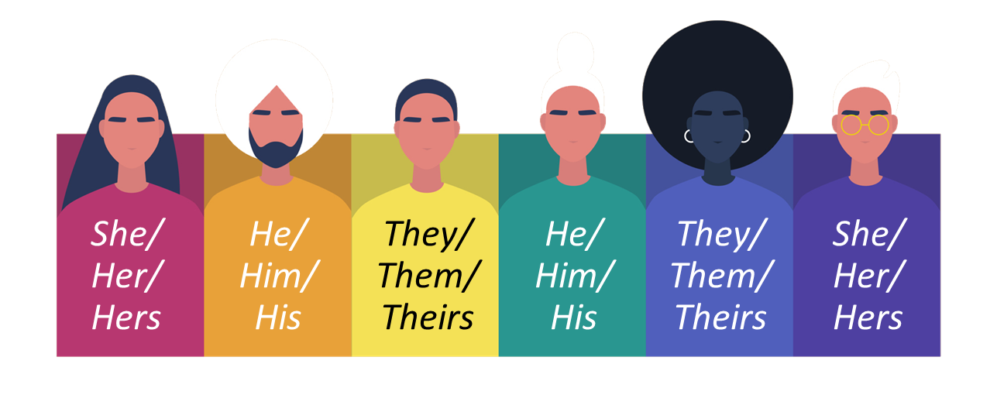
What are Gender Pronouns?
Using pronouns avoids having to use a person's name over and over again in the same sentence.
In English, pronouns are gendered (have an implied gender).
Unless you ask first, replacing a person's name with a pronoun will lead to assumptions about that
person's gender identity that may not be correct.
10 of 33
Click NEXT to continue.
Notes:
Pronouns are often shortcuts in the English language. They avoid having to use a person's name over and over again in the same sentence.
In English, pronouns are gendered or have a gender implied. Such as “he” to refer to a man/boy or “she” to refer to a woman/girl.
So, unless you ask first, replacing a person's name with a pronoun leads to making assumptions about that person's gender identity. These associations are not always accurate or helpful.

Slide 22
Pronoun Usage: Being a Better Ally
Update onscreen text and layout
Click each pronoun to learn about them.
Pronoun
He, him, his
She, her, hers
They, them, theirs
Nominative
Oblique
Possessive
Reflexive
Sentences
11 of 32
Notes:
Click each pronoun to learn how to be more inclusive and respectful of all gender and non-gender conforming identities.

Slide 23
Pronoun Usage: Being a Better Ally
Update onscreen text
Click each pronoun to learn about them.
Pronoun
He, him, his
She, her, hers
They, them, theirs
Nominative
He is going out
She is going out
They are going out
Oblique
I saw him yesterday
I saw her yesterday
I saw them yesterday
Possessive
That dog is his
His dog is sweet
That dog is hers
Her dog is sweet
That dog is theirs
Their dog is sweet
Reflexive
He likes himself
She likes herself
They like themselves
Sentences
He went to the store to find dog food to feed his new puppy.
The store clerk helped him find the right kind, and he got the bag down from the shelf all by himself.
She went to the store to find dog food to feed her new puppy.
The store clerk helped her find the right kind, and she got the bag down from the shelf all by herself.
They went to the store to find dog food to feed their new puppy.
The store clerk helped them find the right kind, and they got the bag down from the shelf all by themselves.
11 of 32
Click NEXT to continue.

Slide 24
Pronoun Usage: Being a Better Ally
New slide, should sync with audio
There are many new pronouns that refer to a singular neutral or nonbinary person.
Pronoun
Ze, Xem, Xyrs (zee, zem, zeers)
Xe, Hir, Hirs (zee, hear, hears)
Nominative
Xe is going out
Ze is going out
Oblique
I saw xem yesterday
I saw hir yesterday
Possessive
That dog is xyrs
Xyr dog is sweet
That dog is hirs
Hir dog is sweet
Reflexive
Xe likes xemself
Ze likes hirself
Sentences
Xe went to the store to find dog food to feed xyr new puppy.
The store clerk helped xem find the right kind, and xe got the bag down from the shelf all by xemself.
Ze went to the store to find dog food to feed hir new puppy.
The store clerk helped hir find the right kind, and ze got the bag down from the shelf all by hirself.
Its important to respect whatever pronouns someone uses.
11 of 32
Click NEXT to continue.
Notes:
There are many new pronouns used in English, as well as other languages, that refer to a singular neutral or nonbinary person.
Sometimes these new pronouns are challenging to introduce into colloquial vernacular, so here you will find how they are used.
As always, what's most important is to respect whatever pronouns someone uses.

Slide 25

What is Misgendering?
Update AS
Misgendering is associating a person with a gender, name, or pronoun that does not correctly reflect the gender with which they identify.
Example: If you call a transgender person by their old name (or dead name) or incorrect pronouns, you are misgendering that person.
The best way to move on is to thank the person who corrected you and work to get it right next time.
12 of 33
Click NEXT to continue.
Notes:
When it’s about pronouns and other concepts having to do with gender identity, it’s important to understand what misgendering is.
Misgendering is when you associate a person with a gender, name, or pronoun that does not correctly reflect the gender with which they identify. Misgendering is often unintentional, however, it still may harm for the person experiencing it.
For example, if you know a transgender person who recently changed their name, and you accidentally use their old name (or dead name), you are unintentionally misgendering that person. We no longer use dead names because they should never be shared, even when referring to that person in the past before they transitioned.
Keep in mind, mistakes happen! No one is perfect. The best way to move on is to simply thank the person who corrected you and work to get it right next time.

Slide 26
Inclusive Language
Identify the gender-neutral and gender-biased phrases from the given options.
Click and drag the phrases into the spaces provided. Incorrect ones will fly back.
Drop here
Drop here
Gender-neutral
Hey guys
Gender-biased
Hey ladies
Hey folks
Hey handsome
Hey team
Hey you all
Hey everyone
13 of 33
Notes:
Identify the gender-neutral and gender-biased phrases from the given options.
Click and drag the phrases into the spaces provided. Incorrect ones will fly back.

Slide 27
Inclusive Language
Identify the gender-neutral and gender-biased phrases from the given options.
Click and drag the phrases into the spaces provided. Incorrect ones will fly back.
Gender-neutral
Gender-biased
Hey folks
Hey guys
Hey team
Hey ladies
Hey you all
Great Job!
Hey handsome
Hey everyone
13 of 33
Click NEXT to continue.
Notes:
Great job! Using more inclusive terms, like Folks, Team, You all, or Everyone, will create an environment that is inclusive of all gender identities.

Slide 28

Think About It
Do you find it difficult to use the correct gender pronouns?
Yes
Not sure
14 of 33
Click NEXT to continue.
Notes:
Do you find it difficult to use the correct gender pronouns?

Slide 29
Think About It
Do you find it difficult to use the correct gender pronouns?
Yes
Not sure
Most people have similar reasons for not finding the usage of inclusive pronouns relevant or easy.
They don't understand or are struggling to understand how to use gender pronouns properly.
14 of 33
Click NEXT to continue.
Notes:
Most people have similar reasons for not finding the usage of inclusive pronouns relevant or easy. They don't understand or are struggling to understand how to use gender pronouns properly.

Slide 30
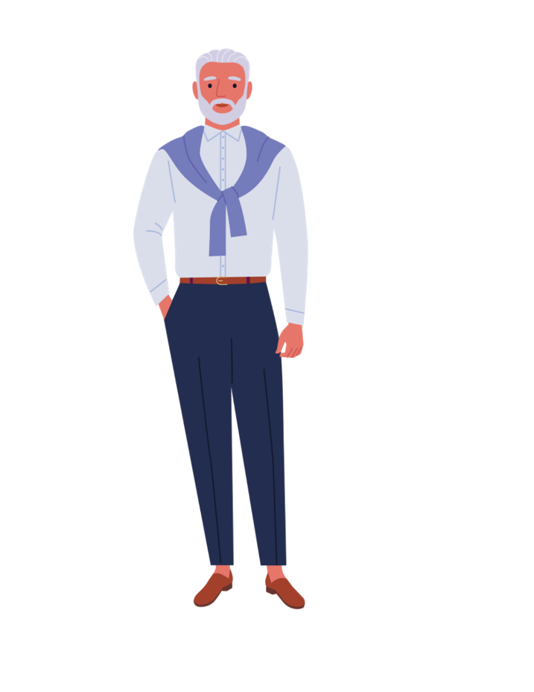

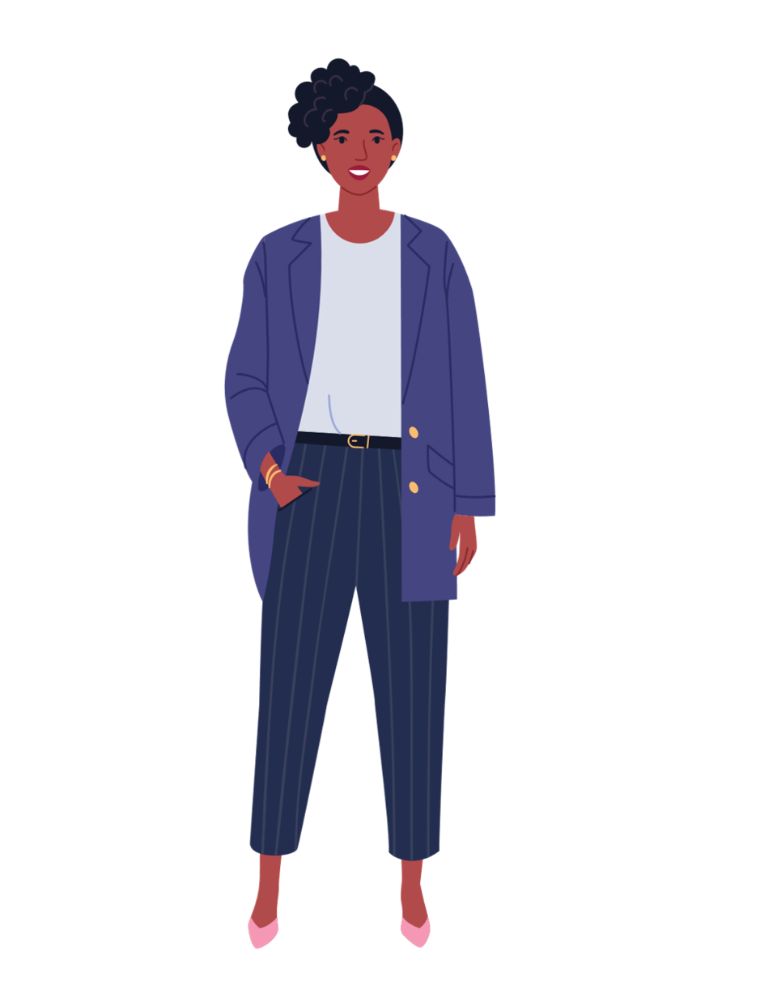

Common Concerns
Click each image to learn about the common concerns.
It’s just too hard to say. I don’t always get how to use it.
I preferred it when there were only two choices.
Singular “they” is not grammatically correct.
How am I supposed to know what pronouns someone uses?
15 of 33
Notes:
Click each image to learn about the common concerns.

Slide 31
Common Concerns
Click each image to learn about the common concerns.
It’s just too hard to say. I don’t always get how to use it.
I preferred it when there were only two choices.
Singular “they” is not grammatically correct.
How am I supposed to know what pronouns someone uses?
The more we practice and make space for pronouns to be normalized, the easier it gets.
As with anything new, it just takes practice to become more familiar and comfortable.
15 of 33
Notes:
For some people its hard to say the pronouns. They don’t always get how to use it.
The solution is, more practice. The more we practice and make space for pronouns to be normalized, the easier it gets.
For the most part, as with anything new, it just takes practice to become more familiar and comfortable.

Slide 32
Common Concerns
Update AS
Click each image to learn about the common concerns.
It’s just too hard to say. I don’t always get how to use it.
I preferred it when there were only two choices.
Singular “they” is not grammatically correct.
How am I supposed to know what pronouns someone uses?
When we don't know the gender of someone we're talking about, it’s better to substitute “they” instead of using “he” or “she.”
For example, “I heard Sam just had a new baby. What is their name?”
15 of 33
Notes:
Some people preferred it when there were only two choices.
The solution is, when we don't know the gender of someone we're talking about, it’s better to substitute “they” instead of using “he” or “she”. “she.”
For example, “I heard Sam just had a new baby. What is their name?”

Slide 33
Common Concerns
Click each image to learn about the common concerns.
It’s just too hard to say. I don’t always get how to use it.
I preferred it when there were only two choices.
Singular “they” is not grammatically correct.
How am I supposed to know what pronouns someone uses?
The singular “they” was added to the dictionary in 2018.
We unconsciously use it all the time in English.
For example, "Someone left their phone at the bar. I should get it back to them somehow. I'm sure they are looking for it."
15 of 33
Notes:
Some people may say that, the singular “they” is not grammatically correct.
Actually, the singular “they” was added to the dictionary in 2018. As with many languages, the English language is fluid, it changes and adapts to how it's used in our day-to-day world, and the singular “they” is no exception.
While it can feel awkward at first when starting to incorporate the singular “they” into daily usage, the truth is, we use it all the time in English, often without realizing it.
For example, "Someone left their phone at the bar. I should get it back to them somehow. I'm sure they are looking for it.“

Slide 34
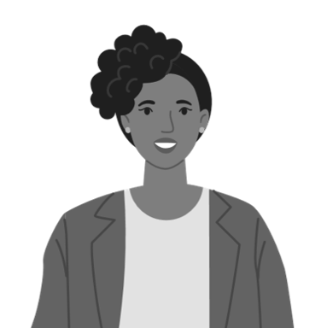
Common Concerns
Click each image to learn about the common concerns.
It’s just too hard to say. I don’t always get how to use it.
I preferred it when there were only two choices.
Singular “they” is not grammatically correct.
How am I supposed to know what pronouns someone uses?
When you aren’t sure what pronouns to use, just ask!
The best way to ask is by first sharing your pronouns and then asking others.
If you’re unable to ask someone's pronouns privately, use their name until you know for sure.
15 of 33
Click NEXT to continue.
Notes:
As with anything about a person you’re meeting for the first time (like their name!) when you aren’t sure what pronouns to use, simply asking is the best practice.
The best way to ask is by first sharing your pronouns and then asking others.
If you’re unable to ask someone's pronouns privately, use their name until you know for sure.

Slide 35

Recalling Subtle Acts of Exclusion (SAE)
Update AS
Subtle
Acts
Exclusion
It doesn't always feel subtle when it happens to you, but the subtlety makes it so that it keeps happening.
They are things people say and do, not just intentions.
They create and perpetuate the exclusion of people from marginalized backgrounds and identities.
16 of 33
Click NEXT to continue.
Notes:
Let’s recall what Subtle Acts of Exclusion (SAE) are.
Subtle: It doesn't always feel subtle when it happens to you, but the subtlety makes it so that it keeps happening.
Acts: They are things people say and do, not just intentions.
Exclusion: They create and perpetuate the exclusion of people with from marginalized backgrounds and identities.

Slide 36

Taking Action: Build Empathy – Scenario 1
How can Matthew’s colleagues help ensure this doesn’t keep happening?
Select the correct answer and click CHECK.
They can have a policy to ask everyone's gender identity
They can make a point to always use gender-neutral terms for significant others
They should ask Matthew if he is straight or gay
When Matthew started his new job, it was around the holidays, and there were lots of parties taking place both virtual and in person. People would ask him if his girlfriend or wife would be attending. Every time this happened, his heart would pound, his palms would sweat, knowing he’d have to come out, again, to his coworkers. “I have a husband,” he’d say and watch various ranges of surprise take over their faces.
CHECK
17 of 33
Notes:
Have a look at this situation.
When Matthew started his new job, it was around the holidays, and there were lots of parties taking place both virtual and in person. People would ask him if his girlfriend or wife would be attending. Every time this happened, his heart would pound, his palms would sweat, knowing he’d have to come out, again, to his coworkers. “I have a husband,” he’d say and watch various ranges of surprise take over their faces.
How can Matthew’s colleagues help ensure this doesn’t keep happening?
Select the correct answer and click CHECK.

Slide 37
Taking Action: Build Empathy – Scenario 1
Added AS
How can Matthew’s colleagues help ensure this doesn’t keep happening?
Select the correct answer and click CHECK.
They can have a policy to ask everyone's gender identity
They can make a point to always use gender-neutral terms for significant others
They should ask Matthew if he is straight or gay
When Matthew started his new job, it was around the holidays, and there were lots of parties taking place both virtual and in person. People would ask him if his girlfriend or wife would be attending. Every time this happened, his heart would pound, his palms would sweat, knowing he’d have to come out, again, to his coworkers. “I have a husband,” he’d say and watch various ranges of surprise take over their faces.
Excellent! Matthew’s colleagues should use gender-neutral terms like “spouse” or “partner” to refer to his significant other.
17 of 33
Click NEXT to continue.
Notes:
Excellent! Matthew’s colleagues should use gender-neutral terms like “spouse” or “partner” to refer to his significant other.

Slide 38
Taking Action: Build Empathy – Scenario 1
Added AS
How can Matthew’s colleagues help ensure this doesn’t keep happening?
Select the correct answer and click CHECK.
They can have a policy to ask everyone's gender identity
They can make a point to always use gender-neutral terms for significant others
They should ask Matthew if he is straight or gay
When Matthew started his new job, it was around the holidays, and there were lots of parties taking place both virtual and in person. People would ask him if his girlfriend or wife would be attending. Every time this happened, his heart would pound, his palms would sweat, knowing he’d have to come out, again, to his coworkers. “I have a husband,” he’d say and watch various ranges of surprise take over their faces.
Not quite. Matthew’s colleagues should use gender-neutral terms like “spouse” or” partner” to refer to his significant other.
17 of 33
Click NEXT to continue.
Notes:
Not quite. Matthew’s colleagues should use gender-neutral terms like “spouse” or” partner” to refer to his significant other.

Slide 39
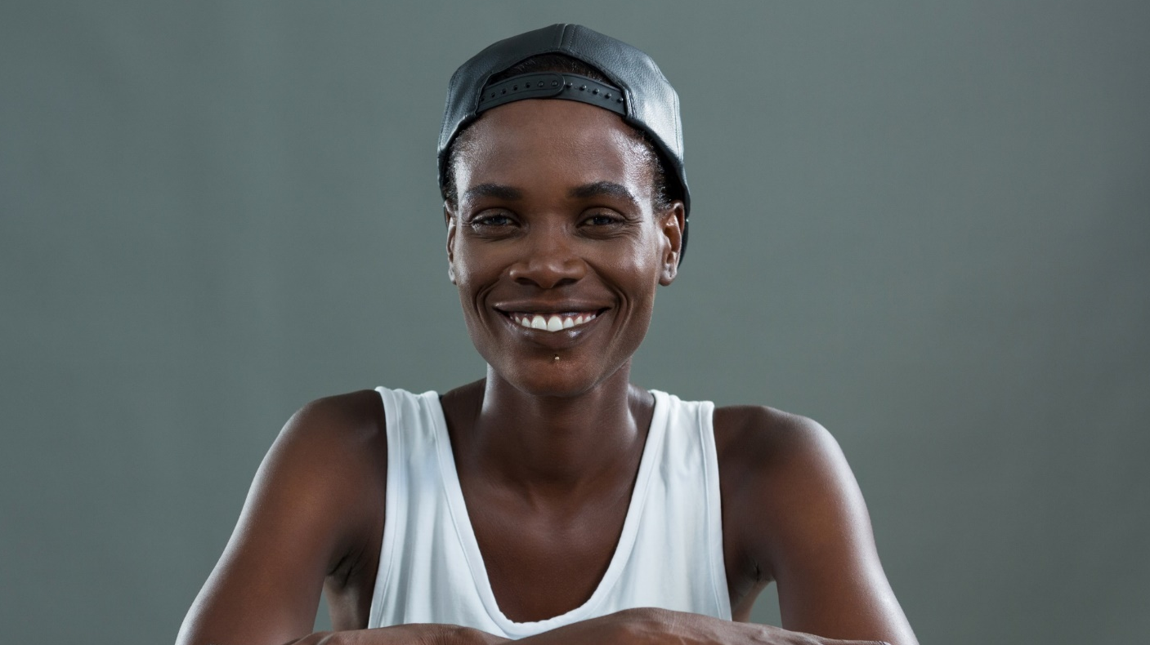
Taking Action: Build Empathy – Scenario 2
Update AS
Do you think introducing pronouns was necessary?
Select the correct answer and click CHECK.
Yes
No
After Dani signed a new client, they became the primary point of contact. Anticipating the awkward moment and blank stares they often get when they share their pronouns as they/them, Dani reached out to the program manager to introduce themselves. Before they said anything, the program manager said, “Hi! I’m Emily, and I use she/her pronouns. I’m looking forward to working with you! What pronouns do you use?” Dani felt at ease and took a deep breath.
CHECK
18 of 33
Notes:
Here’s another situation, after Here’s another situation. After Dani signed a new client, they became the primary point of contact. Anticipating the awkward moment and blank stares they often get when they share their pronouns as they/them, Dani reached out to the program manager to introduce themselves. Before they said anything, the program manager said, “Hi! I’m Emily, and I use she/her pronouns. I’m looking forward to working with you! What pronouns do you use?” Dani felt at ease and took a deep breath.
Do you think introducing pronouns was necessary?
Select the correct answer and click CHECK.

Slide 40
Taking Action: Build Empathy – Scenario 2
Added AS
Do you think introducing pronouns was necessary?
Select the correct answer and click CHECK.
Yes
No
After Dani signed a new client, they became the primary point of contact. Anticipating the awkward moment and blank stares they often get when they share their pronouns as they/them, Dani reached out to the program manager to introduce themselves. Before they said anything, the program manager said, “Hi! I’m Emily, and I use she/her pronouns. I’m looking forward to working with you! What pronouns do you use?” Dani felt at ease and took a deep breath.
Excellent! Sharing pronouns while introducing yourself helps encourage others to do the same, minimizes assumptions, and makes space for people who use nonbinary pronouns.
18 of 33
Click NEXT to continue.
Notes:
Excellent! Sharing pronouns while introducing yourself helps encourage others to do the same, minimizes assumptions, and makes space for people who use nonbinary pronouns.

Slide 41
Taking Action: Build Empathy – Scenario 2
Added AS
Do you think introducing pronouns was necessary?
Select the correct answer and click CHECK.
Yes
No
After Dani signed a new client, they became the primary point of contact. Anticipating the awkward moment and blank stares they often get when they share their pronouns as they/them, Dani reached out to the program manager to introduce themselves. Before they said anything, the program manager said, “Hi! I’m Emily, and I use she/her pronouns. I’m looking forward to working with you! What pronouns do you use?” Dani felt at ease and took a deep breath.
Not quite. Sharing pronouns while introducing yourself helps encourage others to do the same, minimizes assumptions, and makes space for people who use nonbinary pronouns.
18 of 33
Click NEXT to continue.
Notes:
Not quite. Sharing pronouns while introducing yourself helps encourage others to do the same, minimizes assumptions, and makes space for people who use nonbinary pronouns.

Slide 42

Taking Action: Build Empathy – Scenario 3
How might this situation have been avoided?
Select the correct answer and click CHECK.
If company policy was to never address one's personal life while at work
If questions are prioritized over assumptions based on race, gender, disability, religion, etc.
If Todd made a point to ask every employee about their marital status and family structure
This is Alma. One afternoon after a long meeting, the team started casually discussing everyone’s children. Later, Alma’s manager, Todd, messaged them and said, “I’m sorry if that conversation was upsetting for you.” Alma was confused and asked what he meant. Todd said, “I wasn’t sure if you could have children; I didn’t want you to feel uncomfortable.” Alma told Todd that their wife is pregnant with a second child. Todd apologized to Alma for the assumption and thanked them for correcting him.
CHECK
19 of 33
Notes:
This is Alma. One afternoon after a long meeting, the team started casually discussing everyone’s children. Later, Alma’s manager, Todd, messaged them and said, “I’m sorry if that conversation was upsetting for you.” Alma was confused and asked what he meant. Todd said, “I wasn’t sure if you could have children; I didn’t want you to feel uncomfortable.” Alma told Todd that their wife is pregnant with a second child. Todd apologized to Alma for the assumption and thanked them for correcting him.
How might this situation have been avoided?
Select the correct answer and click CHECK.

Slide 43
Taking Action: Build Empathy – Scenario 3
Added AS
How might this situation have been avoided?
Select the correct answer and click CHECK.
If company policy was to never address one's personal life while at work
If questions are prioritized over assumptions based on race, gender, disability, religion, etc.
If Todd made a point to ask every employee about their marital status and family structure.
This is Alma. One afternoon after a long meeting, the team started casually discussing everyone’s children. Later, Alma’s manager, Todd, messaged them and said, “I’m sorry if that conversation was upsetting for you.” Alma was confused and asked what he meant. Todd said, “I wasn’t sure if you could have children; I didn’t want you to feel uncomfortable.” Alma told Todd that their wife is pregnant with a second child. Todd apologized to Alma for the assumption and thanked them for correcting him.
Excellent! A company culture that makes space for questions to be asked rather than assumptions to be made often avoids uncomfortable situations.
19 of 33
Click NEXT to continue.
Notes:
Excellent! A company culture that makes space for questions to be asked rather than assumptions to be made often avoids uncomfortable situations.

Slide 44
Taking Action: Build Empathy – Scenario 3
Added AS
How might this situation have been avoided?
Select the correct answer and click CHECK.
If company policy was to never address one's personal life while at work
If questions are prioritized over assumptions based on race, gender, disability, religion, etc.
If Todd made a point to ask every employee about their marital status and family structure.
This is Alma. One afternoon after a long meeting, the team started casually discussing everyone’s children. Later, Alma’s manager, Todd, messaged them and said, “I’m sorry if that conversation was upsetting for you.” Alma was confused and asked what he meant. Todd said, “I wasn’t sure if you could have children; I didn’t want you to feel uncomfortable.” Alma told Todd that their wife is pregnant with a second child. Todd apologized to Alma for the assumption and thanked them for correcting him.
Not quite. A company culture that makes space for questions to be asked rather than assumptions to be made often avoids uncomfortable situations.
19 of 33
Click NEXT to continue.
Notes:
Not quite. A company culture that makes space for questions to be asked rather than assumptions to be made often avoids uncomfortable situations.

Slide 45

Keep in Mind
When using personal pronouns, keep in mind:
1
We all react differently.
2
We can’t know how an individual feels until they tell us.
3
We should not assume and always be sure to ask first.
20 of 33
Click NEXT to continue.
Notes:
When using personal pronouns, keep in mind that:
We all react differently,
We can’t know what an individual feels until they tell us,
And, we should not assume and always be sure to ask first.

Slide 46
Challenge
What should you do if you are unsure of which pronouns a person uses?
Select ALL the correct answers and click CHECK.
Ask the person what pronouns they use
Share your pronouns first
Address with their name unless you are sure of which pronouns they use
CHECK
21 of 33
Notes:
It’s time for an activity!
What should you do if you are unsure of which pronouns a person uses?
Select all the correct answers and click CHECK.

Slide 47
Challenge
Added AS
What should you do if you are unsure of which pronouns a person uses?
Select ALL the correct answers and click CHECK.
Ask the person what pronouns they use
Share your pronouns first
Address with their name unless you are sure of which pronouns they use
Excellent! Always ask before making assumptions about what pronouns someone uses. When you're unsure, start by sharing yours and address them with their name until you know for sure.
21 of 33
Click NEXT to continue.
Notes:
Excellent! Always ask before making assumptions about what pronouns someone uses. When you're unsure, start by sharing yours and address them with their name until you know for sure.

Slide 48
Challenge
Added AS
What should you do if you are unsure of which pronouns a person uses?
Select ALL the correct answers and click CHECK.
Ask the person what pronouns they use
Share your pronouns first
Address with their name unless you are sure of which pronouns they use
Not quite. Always ask before making assumptions about what pronouns someone uses. When you're unsure, start by sharing yours and address them with their name until you know for sure.
21 of 33
Click NEXT to continue.
Notes:
Not quite. Always ask before making assumptions about what pronouns someone uses. When you're unsure, start by sharing yours and address them with their name until you know for sure.

Slide 49
Course Structure
Gender Identities
Gender Pronouns
Shift your Thinking
Summary
04 of 33
Notes:
Now, let’s shift your thinking with best practices of gender inclusion.

Slide 50
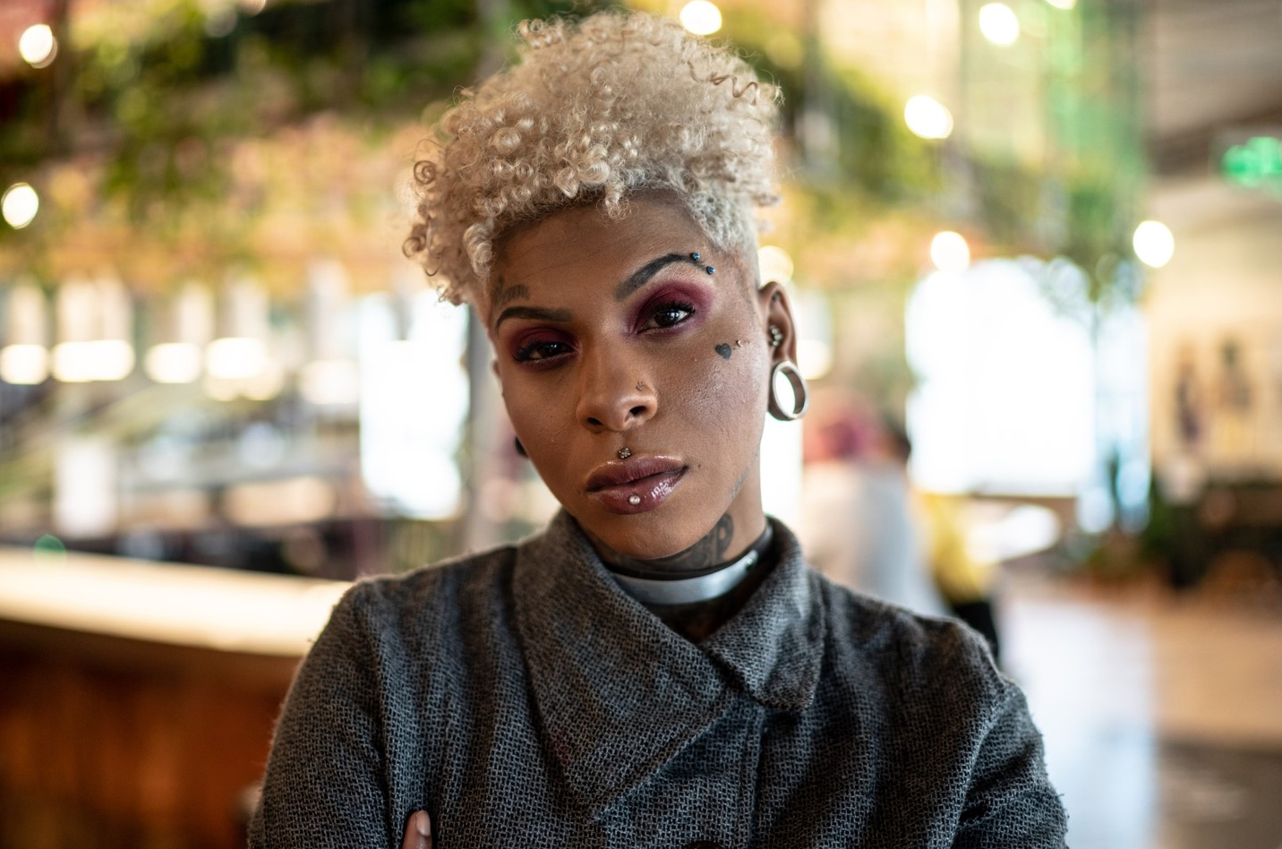
Remember: It’s Not About Intent, It’s About Impact
Update AS and OS
When someone hurts or offends another person, the perpetrator's intent is not what's most important when gauging the appropriateness of an action.
If you feel:
Someone was hurt by something
Someone suffered in a way
There was a negative outcome
Focus on the feelings and experiences of the person who has been harmed or offended.
That is what’s important!
Click here to learn why it’s so hard to prioritize impacts impact over intent.
22 of 33
Click NEXT to continue.
Notes:
Here’s a general rule when it comes to the use of pronouns. When someone does something hurtful or offensive to another person, the perpetrator's intent is not what's most important when gauging the appropriateness of an action.
If you feel someone was hurt by something, someone suffered in a way, and/or there was a negative outcome, then that is what’s important. Whether or not the perpetrator meant to cause harm is not.
Rather, focus on the feelings and experiences of the person who has been harmed or offended.
People from underrepresented groups often experience these acts of exclusion regularly, and you should prioritize their experience whether you meant to cause harm or not.
Click here to learn why it’s so hard to prioritize impacts impact over intent.

Slide 51
Challenge
What can we gain from using pronouns correctly?
Select ALL the correct answers and click CHECK.
More trust across differences
Deeper interpersonal relationships
Understanding and eliminating assumptions
A culture of kindness, transparency, and accountability
Improved ability to give authentic feedback on other issues
CHECK
23 of 33
Notes:
What can we gain from using pronouns correctly?
Select all the correct answers and click CHECK.

Slide 52
Challenge
Added AS
What can we gain from using pronouns correctly?
Select ALL the correct answers and click CHECK.
More trust across differences
Deeper interpersonal relationships
Understanding and eliminate assumptions
A culture of kindness, transparency, and accountability
Improved ability to give authentic feedback on other issues
Excellent! All of these are correct.
23 of 33
Click NEXT to continue.
Notes:
Excellent! All of these are correct.

Slide 53
Challenge
Added AS
What can we gain from using pronouns correctly?
Select ALL the correct answers and click CHECK.
More trust across differences
Deeper interpersonal relationships
Understanding and eliminate assumptions
A culture of kindness, transparency, and accountability
Improved ability to give authentic feedback on other issues
Not quite. All of these are correct.
23 of 33
Click NEXT to continue.
Notes:
Not quite. All of these are correct.

Slide 54
How to Shift our Thinking: Response to Feedback
OS: Period added before quote marks
Express Gratitude
Understand Impact
Use the Opportunity to Grow
Follow Through
(Next day, next week)
“Thank you for speaking up.”
“I appreciate you sharing.”
“I am glad you said something.”
“Can you tell me more about this?”
“Can you help me understand how this impacted you?”
Just listen.
“It’s important to me to learn from this experience.”
After the interaction, self-reflect.
After the interaction, do some research.
“I thought about what you said.”
“I want to check back in with you.”
“Our relationship is important to me.”
Source: Dr. Tiffany Jana and Dr. Michael Baran’s Book: “Subtle Acts of Exclusion: How to Understand, Identify, and Stop Microaggressions.“
24 of 33
Click NEXT to continue.
Notes:
Take a minute to look at the various ways to express gratitude, understand the impact of what has been shared, use the opportunity to grow, and follow through on the feedback received.

Slide 55





Questions To Ask Yourself
How am I reacting physically and emotionally to what I just witnessed or experienced?
What’s the context? Who is around? Where are we? What’s going on?
Are there assumptions or hot-buttons influencing me at this moment?
What are the backgrounds and perspectives of those around? Are they different from mine?
Am I ready for this conversation?
25 of 33
Click NEXT to continue.
Notes:
So how do we begin to shift our thinking? Start by taking stock of where you’re at and searching inward. Ask yourself the following questions:
How am I reacting physically and emotionally to what I just witnessed or experienced?
What’s the context? Who is around? Where are we? What’s going on?
Are there assumptions or hot-buttons influencing me at this moment?
What are the backgrounds and perspectives of those around? Are they different from mine?
Am I ready for this conversation?

Slide 56
How to Shift our Thinking: Dos and Don’ts
Identify the Dos and Don’ts while responding to feedback.
Click and drag each option into the spaces provided. Incorrect ones will fly back.
Drop here
Drop here
Dos
Play devil’s advocate.
Don’ts
Thank them. They are giving you a gift.
Try to fix it or come up with solutions.
Try to defend what you said— remember, impact over the intention.
Over apologize or make it into a bigger deal.
Take it seriously.
Apologize and move on.
26 of 33
Notes:
Identify the Dos and Don’ts while responding to feedback.
Click and drag each option into the spaces provided. Incorrect ones will fly back.

Slide 57
How to Shift our Thinking: Dos and Don’ts
Identify the Dos and Don’ts while responding to feedback.
Dos
Don’ts
Thank them. They are giving you a gift.
Play devil’s advocate.
Take it seriously.
Try to fix it or come up with solutions.
Apologize and move on.
Great Job!
Try to defend what you said—remember, impact over the intention.
Over apologize or make it into a bigger deal.
26 of 33
Click NEXT to continue.
Notes:
Great job! Responding to feedback is a very important aspect of communication, and our responses can determine how comfortable or heard the person offering feedback feels.

Slide 58
Demonstrating Allyship
Click each topic to learn more.
Inform and Educate Yourself
Practice Active Listening
Commit to Awareness and Growth
Advocate for Underrepresented Groups
Interrupt Bias and Discrimination
27 of 33
Notes:
By using a person’s correct pronouns, we respect their identity and create an environment that’s more inclusive.
Click each topic to learn how to demonstrate allyship to transgender and non-binary folks.

Slide 59
Demonstrating Allyship
Click each topic to learn more.
Inform and Educate Yourself
Practice Active Listening
Commit to Awareness and Growth
Advocate for Underrepresented Groups
Interrupt Bias and Discrimination
Allies should seek to be informed and aware of how transgender or nonbinary members are affected by wrong pronoun usage and how to use them correctly.
Often, misgendering happens unknowingly or unintentionally. Building inclusion into your everyday language starts with being aware.
27 of 33
Notes:
Allies should proactively seek to be informed and aware of how transgender or nonbinary members can be affected by the usage of the wrong pronouns and how they prefer to be addressed.
This could be a bewildering topic for many cisgender people, who may not necessarily be discriminatory towards non-cis gender people, but who may unknowingly end up being insensitive or alienating them through ignorance.
It may take time to build it into your everyday language, but it starts with being aware. As we familiarize ourselves with why it matters to share pronouns, we create safe spaces for everyone. So educate yourself on how best you can demonstrate your allyship.

Slide 60
Demonstrating Allyship
Click each topic to learn more.
Inform and Educate Yourself
Practice Active Listening
Commit to Awareness and Growth
Advocate for Underrepresented Groups
Interrupt Bias and Discrimination
When allies demonstrate active listening towards transgender and nonbinary people:
They communicate empathy to others.
It signals that they are safe to express feelings, concerns, and needs.
27 of 33
Notes:
Allies should proactively identify themselves as a confidant for transgender or nonbinary members to safely express their feelings, concerns, and needs.
They should practice active listening by asking open-ended questions, confirming interpretations and understandings, affirming others’ experiences as valid, and communicating empathy.
When they hear a person being referred to in the third person with the singular “they” pronoun, they should make note and be sure to refer to them the same way.

Slide 61
Demonstrating Allyship
Click each topic to learn more.
Inform and Educate Yourself
Practice Active Listening
Commit to Awareness and Growth
Advocate for Underrepresented Groups
Interrupt Bias and Discrimination
Allyship is a skill that, like any other, requires practice. While honing this skill, allies should:
Be prepared to face constructive criticism.
Check their thought processes, behaviors, and actions to see how they may be contributing to implicit and explicit systems of discrimination.
Not be defensive or accusatory when approached about wrongdoings but see how they can improve their allyship.
27 of 33
Notes:
Allyship is a skill that, like any other, requires practice.
While they are honing this skill, they will make mistakes and must be prepared to face constructive criticism.
Allies should check their thought processes, behaviors, and actions on an ongoing basis to question how they may be contributing to formal and informal systems of discrimination.
They should not be defensive or accusatory when approached about wrongdoings. They should listen to members of transgender and nonbinary groups when they recommend ways they can improve their allyship.

Slide 62
Demonstrating Allyship
Update AS
Click each topic to learn more.
Inform and Educate Yourself
Practice Active Listening
Commit to Awareness and Growth
Advocate for Underrepresented Groups
Interrupt Bias and Discrimination
Allies should verbally affirm the identities of transgender or nonbinary members, peers, and colleagues.
Cisgender people can lead the change by sharing pronouns.
On a larger scale, allies should use their voices to influence change that directly benefits the experiences and careers of transgender or nonbinary members.
27 of 33
Notes:
Allies should verbally affirm the identities of transgender or nonbinary members, peers, and colleagues. For a cisgender person, there is little to no risk in sharing your pronouns. For a person who is transgender or nonbinary, sharing pronouns can be a bit riskier.
Cisgender people can lead the change by sharing pronouns. It normalizes the process, has little risk, and actually makes for a safer environment for everyone.
On a larger scale, allies should use their voices to influence enterprise-wide change that directly benefits the experiences and careers of transgender or non-binary nonbinary members.

Slide 63
Demonstrating Allyship
Click each topic to learn more.
Inform and Educate Yourself
Practice Active Listening
Commit to Awareness and Growth
Advocate for Underrepresented Groups
Interrupt Bias and Discrimination
Allies should:
Actively combat unfair behavior and demand accountability by calling out biased/discriminatory discussions or decision making as they happen.
In more informal conversations, vocally admonish offensive comments, regardless of whether a transgender or nonbinary person is present.
27 of 33
Notes:
Allies should dynamically combat unfair behaviors, demanding accountability by monitoring and calling out biased/discriminatory discussions or decision making as they happen.
In more informal conversations, allies should vocally admonish any offensive comments, regardless of whether a transgender or nonbinary person is present.

Slide 64





Inclusive Pronouns Matter
When gender pronouns are used correctly:
Everyone feels valued, seen, and that they belong.
Individual team members feel respected.
Everyone feels welcomed and that their opinions and ideas matter.
All team members feel understood.
28 of 33
Click NEXT to continue.
Notes:
In conclusion, using gender pronouns correctly matters because it helps in the following ways:
Everyone feels valued, seen, like they belong.
Individual team members feel respected.
Everyone feels welcomed and that their opinions and ideas matter.
All team members feel understood.

Slide 65

Recap
How do we shift our thinking?
Click each number to learn more.
1
2
3
4
29 of 33
Notes:
Let us briefly recap the main points about how we can shift our thinking to remove barriers to inclusion and what we need to do to demonstrate it.
Click each number to learn more.

Slide 66
Recap
Update AS
How do we shift our thinking?
Click each number to learn more.
1
2
3
4
Address groups with care
Instead of “Hey guys!” use gender-neutral terms like:
You all
Friends
Folks
People
Team
Everybody
29 of 33
Notes:
Often, we use “Hey guys!” as a default greeting, regardless of the gender makeup of a group. The word “guys” isn’t offensive in and of itself, but it assumes masculinity is the norm.
Use gender-neutral terms like y’all you all, friends, folks, people, team, or everybody to include everyone, no matter where they fall on the gender spectrum.

Slide 67
Recap
How do we shift our thinking?
Click each number to learn more.
1
2
3
4
Use non-gendered salutations and honorifics
Minimize gendered salutations and honorifics like sir/ma’am or Mr./Mrs. If necessary, add the neutral honorific, Mx.
Ask new people what pronouns they use. Start by sharing yours.
29 of 33
Notes:
We’re used to using gendered salutations and honorifics like sir or ma’am and Mr. or Mrs. to show respect. But when we use these by default, we risk misgendering people, especially nonbinary people.
Ask new people what pronouns and language they use, and when in doubt, avoid gendered language with neutral terms like the honorific, Mx.

Slide 68
Recap
Update AS – put period inside quote marks
How do we shift our thinking?
Click each number to learn more.
1
2
3
4
Be respectful when referring to significant others.
Use neutral terms like “spouse” or “partner,” unless described otherwise.
If a colleague refers to their significant other with a specific term like “boyfriend” or “wife,” follow their lead.
29 of 33
Notes:
When referring to someone’s significant other, try using neutral words like “spouse” or “partner”. “partner.” Neutral terms ensure you don’t presuppose a person’s sexual orientation.
If your colleague does use a specific term like “boyfriend” or “wife” to refer to their significant other, follow their lead.

Slide 69
Recap
How do we shift our thinking?
Click each number to learn more.
1
2
3
4
Use correct names
Not everyone uses their legal name, and for some, seeing their legal name causes harm and dysphoria.
When legal names are required for documentation, use separate fields for “Name” and “Legal Name.”
29 of 33
Click NEXT to continue.
Notes:
When legal names are required on forms or documentation, remember that not everyone uses their legal name.
Create separate fields for “Name” and “Legal Name” to ensure the correct name is used. Remember, a trans person’s name is real and valid regardless of whether they have changed it legally.

Slide 70
Challenge
Is it okay to use someone's pre-transition name when speaking about them in the past?
Select the correct answer and click CHECK.
Always
Sometimes
Never
CHECK
30 of 33
Notes:
It’s time for an activity!
Is it okay to use someone’s pre-transition name when speaking about them in the past?
Select the correct answer and click CHECK.

Slide 71
Challenge
Added AS
Is it okay to use someone's pre-transition name when speaking about them in the past?
Select the correct answer and click CHECK.
Always
Sometimes
Never
Excellent! It's never okay to use a transgender or nonbinary person's old name, also called "dead name" or "birth name." When someone takes a new name or new pronouns, use that name when referring to them, even when speaking about them in the past.
30 of 33
Click NEXT to continue.
Notes:
Excellent! It's never okay to use a transgender or nonbinary person's old name, also called "dead name" or "birth name." When someone takes a new name or new pronouns, use that name when referring to them, even when speaking about them in the past.

Slide 72
Challenge
Added AS
Is it okay to use someone's pre-transition name when speaking about them in the past?
Select the correct answer and click CHECK.
Always
Sometimes
Never
Not quite. It's never okay to use a transgender or nonbinary person's old name, also called "dead name" or "birth name." When someone takes a new name or new pronouns, use that name when referring to them, even when speaking about them in the past.
30 of 33
Click NEXT to continue.
Notes:
Not quite. It's never okay to use a transgender or nonbinary person's old name, also called "dead name" or "birth name." When someone takes a new name or new pronouns, use that name when referring to them, even when speaking about them in the past.

Slide 73
Course Structure
Gender Identities
Gender Pronouns
Shift your Thinking
Summary
04 of 33
Notes:
We have come to the end of the course.
Let’s wrap-up with a quick Summary.

Slide 74

Summary
Click each tab to read and recap.
Gender Identities
Gender Pronouns
Shift your Thinking
31 of 33
Notes:
Click each tab to read and recap.

Slide 75
Summary
Click each tab to read and recap.
Gender Identities
Transgender: A term used for people whose gender identity does not align with how they were assigned at birth.
Nonbinary: A term used for people who identify outside binary genders male/masculine and female/feminine, and instead identify as both, neither, or a combination.
Intersex: A term used for people who have multiple or ambiguous biological sex characteristics, such as hormones, reproductive organs, and genitalia.
Gender Pronouns
Shift your Thinking
31 of 33

Slide 76
Summary
Click each tab to read and recap.
Gender Identities
Gender Pronouns
When using personal pronouns, keep in mind that:
We all react differently.
We can’t know how an individual feels until they tell us.
We should not assume and always be sure to ask first!
Shift your Thinking
31 of 33

Slide 77
Summary
Click each tab to read and recap.
Gender Identities
Gender Pronouns
Shift your Thinking
We begin to shift our thinking when we:
Address groups with care
Use non-gendered salutations and honorifics
Refer to significant others correctly
Use correct names and legal names—include both options on documentation
Describe a person as a person
Share your pronouns
31 of 33
Click NEXT to continue.

Slide 78
You have successfully completed
Inclusive Pronouns
Understanding the Importance of Gender Inclusion
Notes:
Congratulations!
You’ve successfully completed Inclusive Pronouns – Understanding the Importance of Gender Inclusion course.
Please click the Exit button to close the window!

